Slide 1
Leveraging CPEC Karachi
Dr Nadeem Javaid
Chief Economist, Government of Pakistan

Slide 2
Sequence of talk
CPEC
Census 1951-2017
City Competitiveness
Leveraging Karachi, Way Forward !!!

Slide 3
CPEC Cooperation Fields
China Pakistan Economic Corridor Long Term Plan :
Timeframe 2014 – 2030
Components:
Energy (Coal, Hydel, Wind, Solar, LNG , Transmission)
Infrastructure (Road, Rail, Aviation, Data connectivity)
Gwadar Port (Socio-economic development)
Industrial Cooperation (Gwadar Free Zone and other industrial parks to be finalized)
Framework:
Joint Cooperation Committee supported by 5 Joint Working Groups is steering the program.

Slide 4
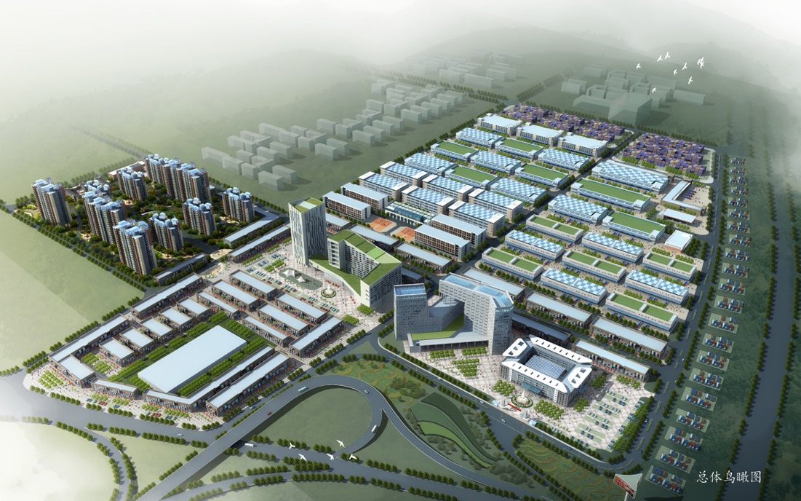
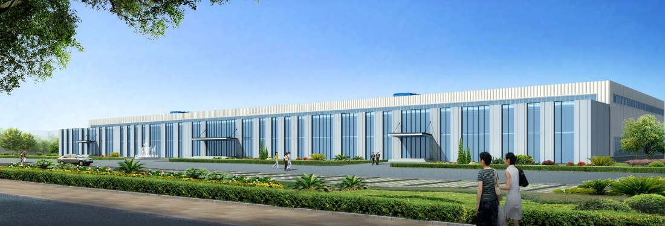
Development Targets
1st Target（2020）: Period of market cultivation. To develop commercial logistics and other industries with local resources.
2nd Target（2025）: Period of expansion and development. Processing and manufacturing industries will be developed.
3rd Target（2030）: Period of Maturity. Enlarge the scale and scope of Free Zone.

Slide 5
Industrial Cooperation under CPEC
Province/Unit | 9 Location for Industrial Zone (6th JCC)
KPK | Rashakai Economic Zone
Sindh | Dhabeji
Balochistan | Bostan Industrial Zone
Punjab | M-2 Sheikhupura
North Area | Moqpondass, Gilgit Baltistan SEZ
Federal Area | ICT Model Industrial Zone & PSM-Port Qasim
FATA | Mohmand Marble City
AJK | Bhimbar Industrial Zone

Slide 6
Opportunities
Electronics, Light Engineering, Chemicals, Automobiles etc.
Textiles
Mines & Minerals
Energy Sector (Oil & Gas Exploration)
Construction
Agriculture, Food processing

Slide 7
Connectivity and Wider Economic Benefits
Economic Corridor
Transport Corridor

Slide 8
Population of Pakistan (in millions) (Census 1951-2017)
*= estimated to fill the gap

Slide 9
Population by Residence Census (1951-2017)

Slide 10
Top cities of Pakistan (Census 1951-2017)
City Rank | 1951 | 1961 | 1972 | 1981 | 1998 | 2017
1 | Karachi | Karachi | Karachi | Karachi | Karachi | Karachi
2 | Lahore | Lahore | Lahore | Lahore | Lahore | Lahore
3 | Hyderabad | Hyderabad | Faisalabad | Faisalabad | Faisalabad | Faisalabad
4 | Rawalpindi | Lyallpur | Hyderabad | Rawalpindi | Rawalpindi | Rawalpindi
5 | Multan | Multan | Rawalpindi | Hyderabad | Multan | Gujranwala
6 | Lyallpur | Rawalpindi | Multan | Multan | Hyderabad | Peshawar
7 | Sialkot | Peshawar | Gujranwala | Gujranwala | Gujranwala | Multan
8 | Peshawar | Gujranwala | Peshawar | Peshawar | Peshawar | Hyderabad
9 | Gujranwala | Sialkot | Sialkot | Sialkot | Quetta | Islamabad
10 | Quetta | Sargodha | Sargodha | Sargodha | Islamabad | Quetta

Slide 11
Population of Pakistan, (Future Projections 2051 based on Census 2017)

Slide 12
Population of Pakistan, (Future Projections 2051 based on Census 2017)

Slide 13
Poverty- Cost of Basic Need (Headcount)

Slide 14
GDP Growth Trend (%)
Data Source: PBS & Planning Commission

Slide 15
Emerging Middle Class
Poverty levels have declined
Middle Class is Emerging ( 80 Million )
Consumer Market is growing

Slide 16
Housing Units - Shortage
Population growth, the continuing trend toward urbanization, and rising incomes are all fueling the increasing demand for housing.
There is 10 Million Housing Units shortage, i.e. further accumulating by 0.34 million units every year !!
Formal financial sector caters only up to 2 % of all housing transactions, the lowest ratio in the region (10-12% is catered by Informal Sector)

Slide 17
Consumer Expenditure on Housing (% of Total Household Expenditure)

Slide 18
How to cater the needs of society?
Horizontal growth is untenable, going vertical is the suitable option;
Economies of Scale
Affordability
Short Commuting
Facilitate Social Mobility
Making cities competitive - developing civic infrastructure compatible with Environment .
Coherent town planning with a Master Plan for City’s Development. (water, sewage, gas, electricity, firefighting, parking, Transport nods and pedestrian-friendly)

Slide 19
Cities as engine of economic growth - Better Urban Policy
Density : Double edge
agglomeration economies; The benefits of spatial concentration include the reduction of transport costs for goods, people, and ideas.
spatial proximity; For millennia, cities have had to deal with the negative consequences of density, which include contagious disease, crime, and congestion.

Slide 20
Competitive Cities Look Like
Accelerated economic growth. The top 10 percent of cities achieved 13.5 percent annual gross domestic product (GDP) per capita growth, compared with 4.7 percent in an average city;
Outstanding job growth. The top 10 percent of cities achieved 9.2 percent annual jobs growth, compared with 1.9 percent in the remaining 90 percent.
Increased incomes and productivity. The top 10 percent of cities increased the average disposable income of their households by 9.8 percent annually.
Magnets for foreign direct investment (FDI). The top 5 percent of cities obtained as much FDI as the bottom 95 percent of cities combined.

Slide 21
Leveraging Karachi Way Forward !!!
Finding the new land;
Damaging Agriculture
Deforestation
Karachi have to remove the barriers;
Regulations promoting rent-seeking
Over-restrictive building codes
Zoning laws
Incentivizing efficiency and innovation (an inclusive approach)
The construction industry needs to evolve;
Opaque marketplace (Informality and corruption)
Poor project management and design processes,
A lack of investment in technology, R&D, and workforce skills
Intensified / Efficient urban land use

Slide 22
Leveraging Karachi Way Forward !!!
4) Governments, (K. City) and Construction Industry urgently need to collaborate for improving the residents’ quality of life and ensure that housing shortages do not become a drag on economic growth.
5) Optimal degree of federalism/provincialism to carve appropriate policies, and the use of engineering and economics approaches to reducing the negative consequences of density.

Slide 23
THANK YOU

